Slide 1
790-133
Language and Vision
Tamara Berg
Features

Slide 2
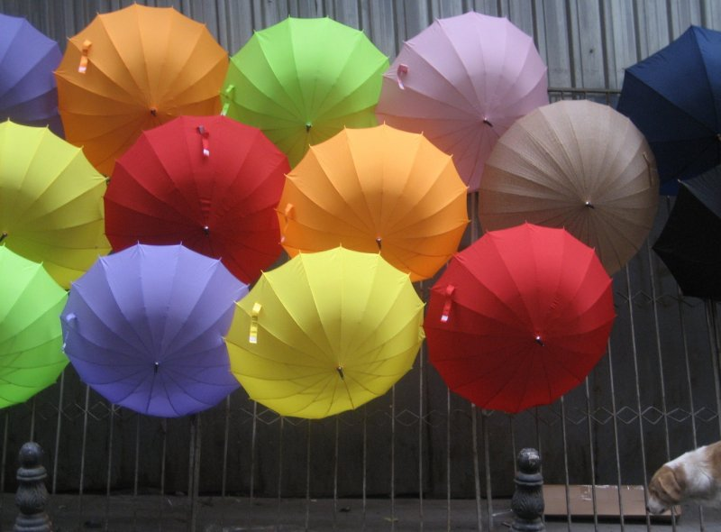
Representing Images
Keep all the pixels!
Pros? Cons?
Notes:
What’s the simplest way to represent an image. Well how about if we just keep all the pixels?
Pros – haven’t lost any information, cons – really big, not invariant to changes in the image.

Slide 3

2nd Try
Compute average pixel
Pros? Cons?

Slide 4

3rd Try
Photo by: marielito
Represent the image as a spatial grid of average pixel colors
Pros?
Cons?
Notes:
Robustness to small changes is good!
Loses information about other kinds of features beyond color – ie shapes of object, texture of vertical lines in background

Slide 5
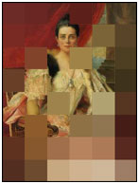
QBIC system
QBIC link
First content based image retrieval system
Query by image content (QBIC)
IBM 1995
QBIC interprets the virtual canvas as a grid of coloured areas, then matches this grid to other images stored in the database.

Slide 6
Feature Choices

Slide 7
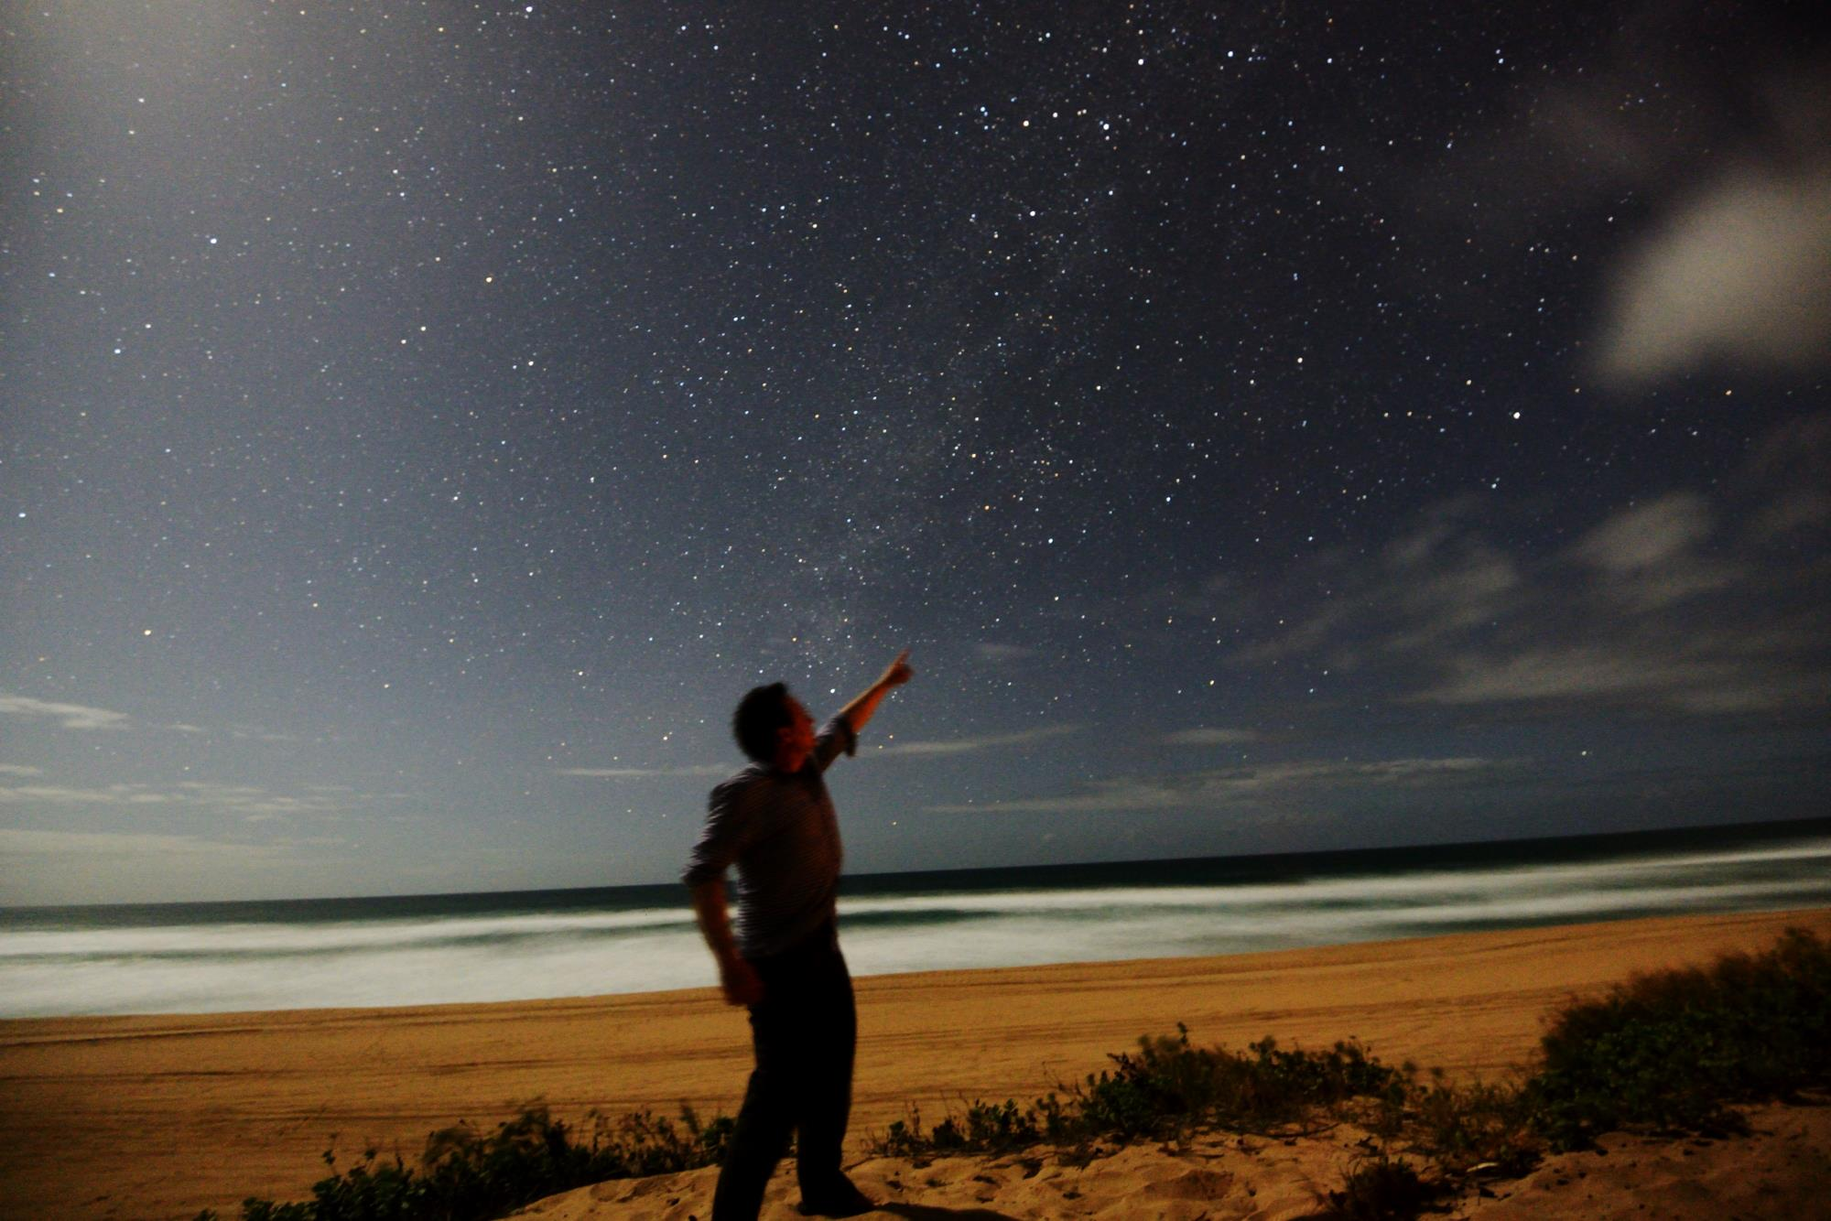
Global vs Local?
Beach
Person
Depends whether you want whole or local image similarity
Notes:
One choice you have to make when deciding how to represent an image is whether you want to compute global or local features – global are computed on the whole image and local on some region within the image.
Q: When might you want to use global? For what types of recognition problems that we’ve talked about?
Q: when might you want to use local?

Slide 8
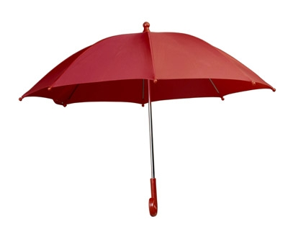
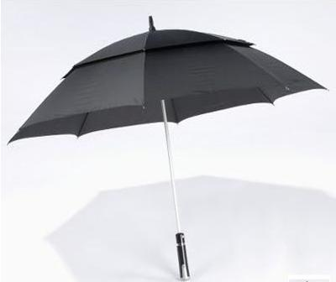
Feature types!
The representation of these two umbrella’s should be similar….
Under a color based representation they look completely different!
Notes:
Then another choice you have to make is what kinds of image information you want to represent. For example, the representation we talked about for the balloon images is an example of a color based representation. That might work well for some tasks – but it wont’ work for others. For example what if we want to recognize umbrellas in images. Then under a color based representation they are going to look completely different!
Q: So what kind of feature that we touched on last class might be useful here?

Slide 9
Outline
Image Representations
Global vs Local – depends on the task
Feature Type: color, shape, texture
Notes:
So today we are going to talk a little bit about different kinds of features, global vs local features as well as different kinds of feature types representing some of the main kinds of features used in computer vision

Slide 10
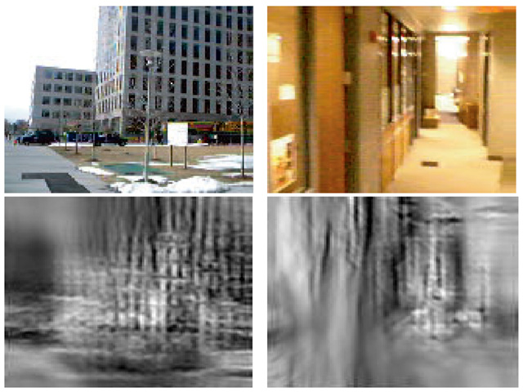
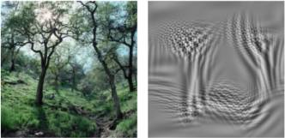
Global Features
The “gist” of a scene: Oliva & Torralba, 2001
Notes:
Global features provide an image representation of the entire image.

Slide 11
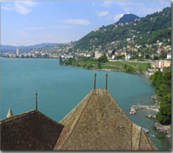
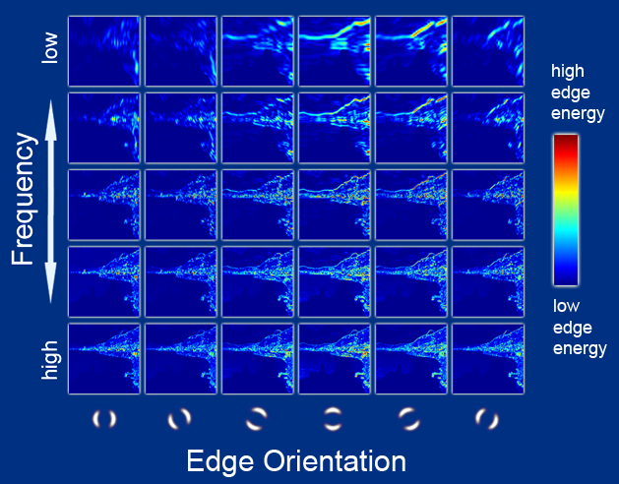
Global Features (gist)
Compute oriented edge response at multiple scales (5 spatial scales, 6 orientations)
Hays and Efros, SIGGRAPH 2007
Notes:
One commonly used global image descriptor is the Gist descriptors which compute a representation that looks like this.
Reminder, how could you calculate these using something we saw last class? By convolving with a filter (in this case a gabor filter) similar to the ones we saw last time. Those were vertical and horizontal edge response filters, but you can also create filters at different orientations to get edges at a variety of orientations. Along the y axis you vary frequency of your edge response – from very high frequency to low frequency edges (filter basically computes differences over small to large spatial extent – so responds to image differences at smaller to larger image spatial extents).

Slide 12
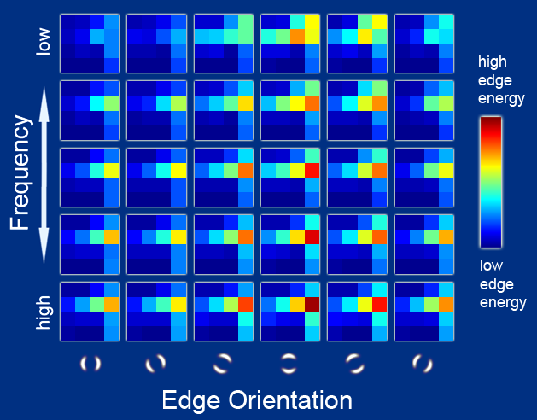
Global features (gist)
Gist scene descriptor (Oliva and Torralba 2001)
“semantic” descriptor of image composition
aggregated edge responses over 4x4 windows
scenes tend to be semantically similar under this descriptor if very close
Hays and Efros, SIGGRAPH 2007
Notes:
These edge responses are aggregated into 4x4 windows over the image into different response bins. So our descriptor for the image becomes a vector of numbers of size (4x4)*number of orientations * number of frequencies, here 4*4*6*5=480 and that becomes a vector representation for the whole image.

Slide 13
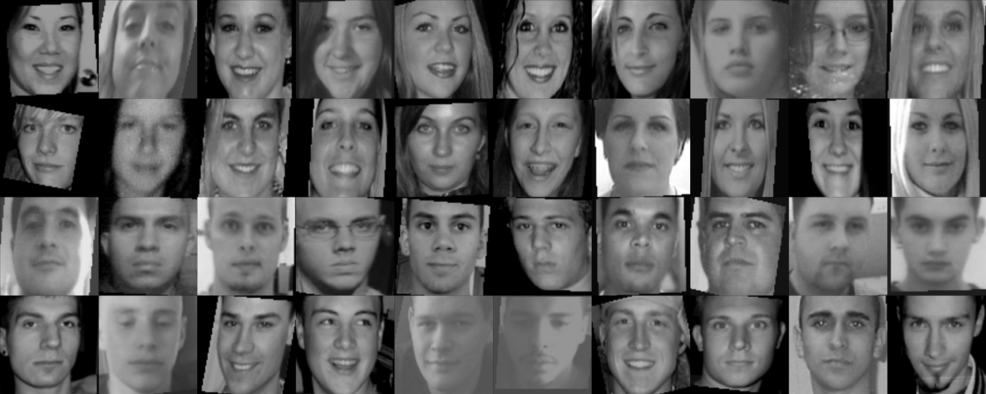
Limitations of global appearance models
Can work on relatively simple patterns
Not robust to clutter, occlusion
Notes:
global representations work when your goal is to recognize an entire scene or for relatively simple patterns like faces. But they are not very robust to things like clutter or occlusion

Slide 14
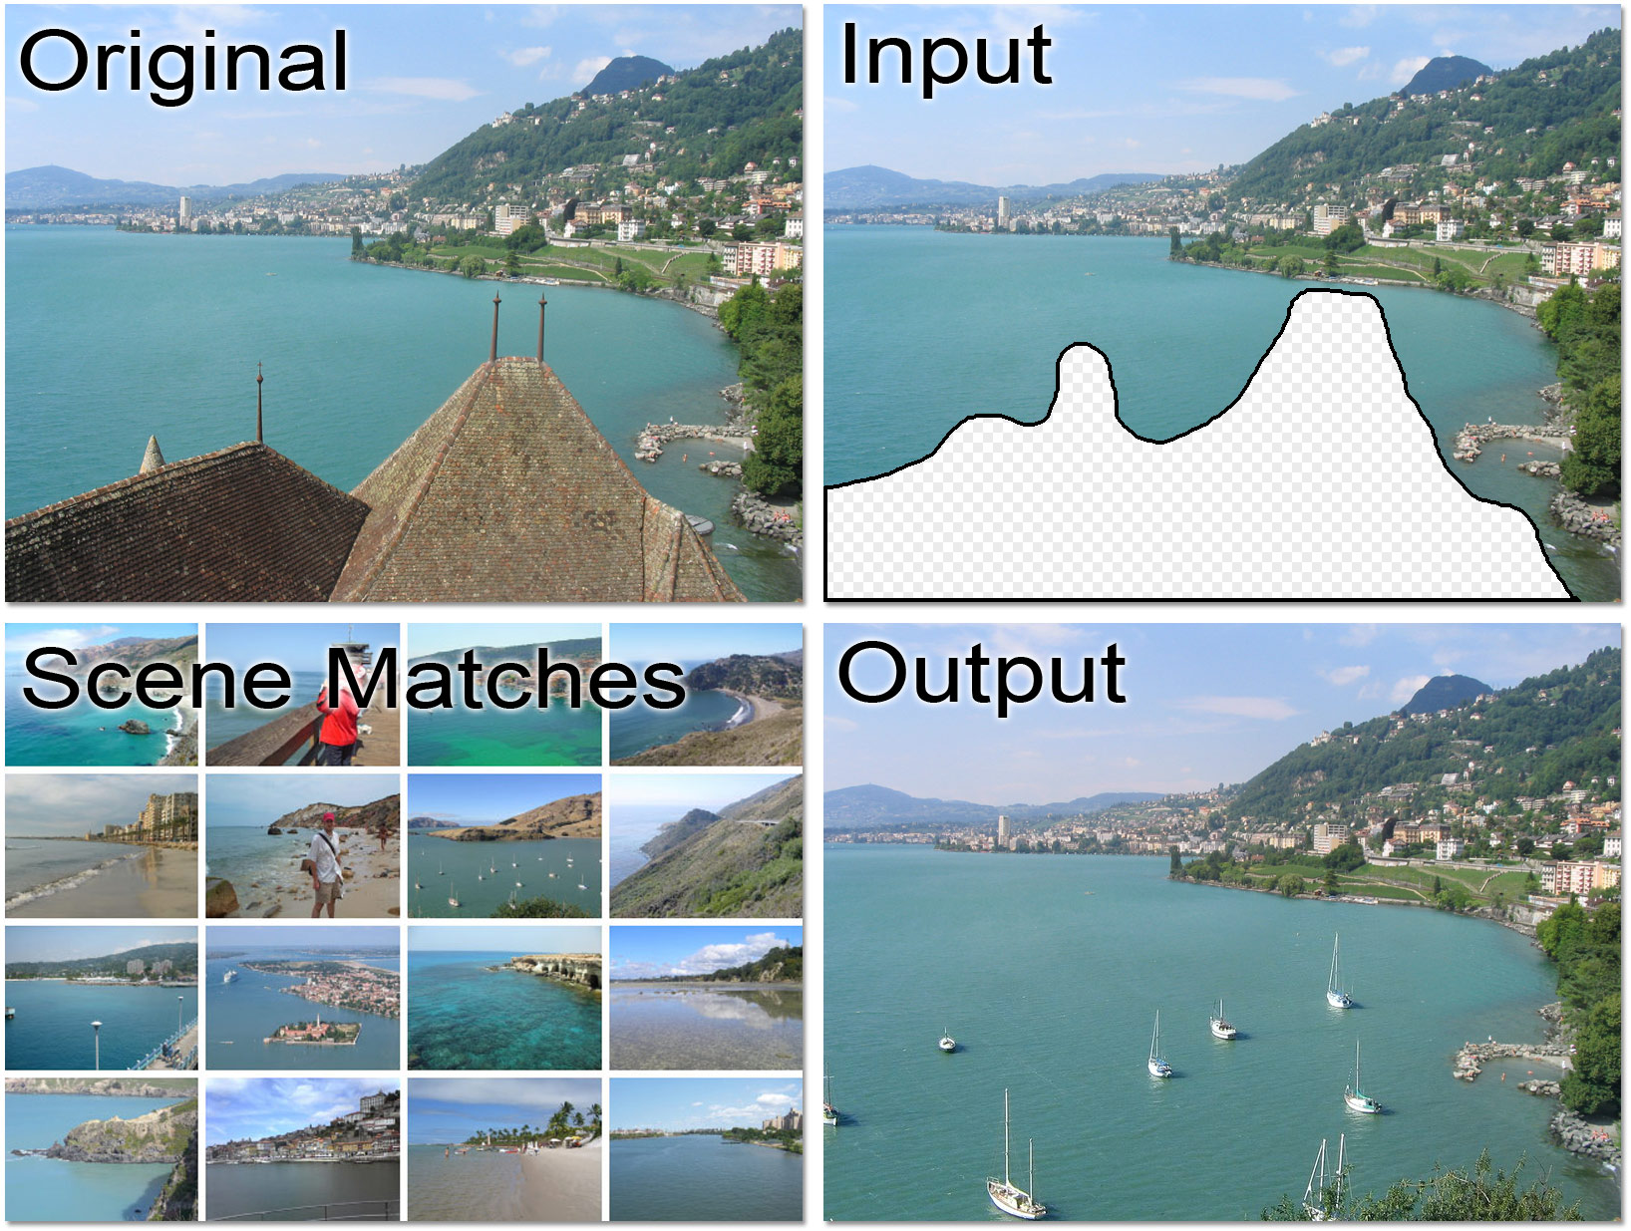
J. Hays and A. Efros, Scene Completion using Millions of Photographs, SIGGRAPH 2007
Recent resurgence of Global models
Notes:
There has been some resurgence of global models recently for things like image retrieval – they are nice because they are fast and easy to use.
For example, one neat way they have been used recently is for hole filling in images. Here they have an image with a hole cut out that they’d like to replace with some other piece. So they use global features to search a huge data base of images for similar looking images. And then paste the output into the hole in their query image.

Slide 15
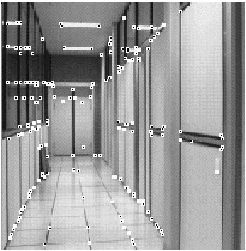
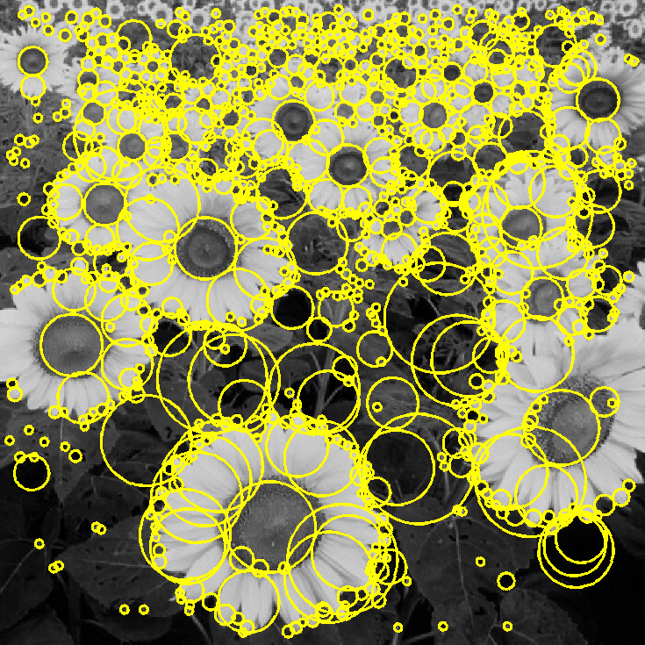
Local Features
Feature points (locations) + feature descriptors
source: Svetlana Lazebnik
Notes:
If you want to represent bits of an image you can use local features – image descriptors that only represent part of an image at a time.

Slide 16


Why extract features?
Motivation: panorama stitching
We have two images – how do we combine them?
source: Svetlana Lazebnik
Notes:
Let’s look at a motivating example. Say you want to do panorama stitching. Here we have two images of the same scene and want to combine them into a single larger image.

Slide 17


Why extract features?
Motivation: panorama stitching
We have two images – how do we combine them?
Step 1: extract features
Step 2: match features
source: Svetlana Lazebnik
Notes:
Common techniques usually extract features from each image, match features across images to find correspondences (features coming from the same world point)

Slide 18

Why extract features?
Motivation: panorama stitching
We have two images – how do we combine them?
Step 1: extract features
Step 2: match features
Step 3: align images
source: Svetlana Lazebnik
Notes:
and then use these correspondences to align the images and stich them together

Slide 19
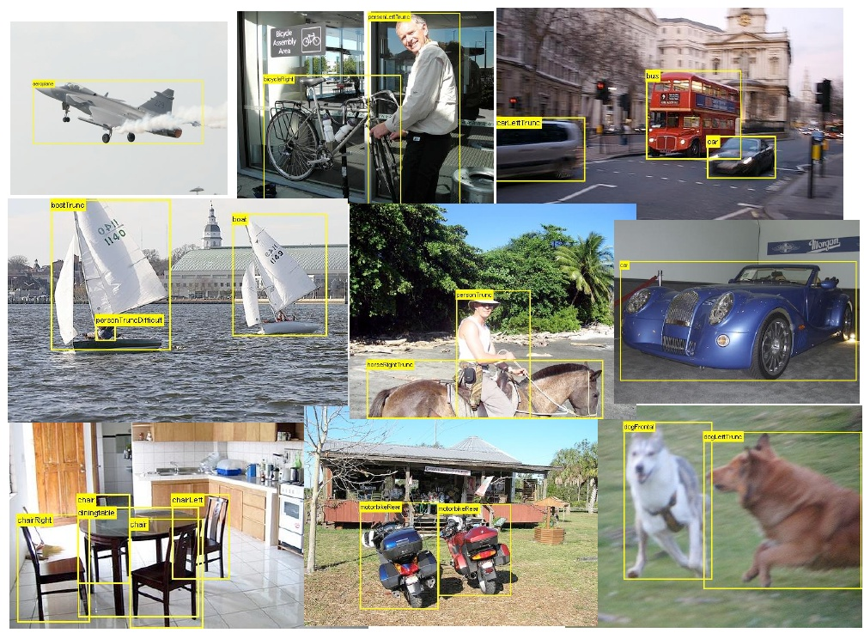
Local Features for object detection
Notes:
Generally local features are used for problems where we want to recognize individual objects in images (esp for objects that are relatively complex with deformable parts, etc), here we might even use models built from multiple parts to describe an object – ie a dog == head, body, legs, tail etc.

Slide 20
Characteristics of good features
Repeatability
The same feature can be found in several images despite geometric and photometric transformations
Saliency
Each feature has a distinctive description
Compactness and efficiency
Many fewer features than image pixels
Locality
A feature occupies a relatively small area of the image; robust to clutter and occlusion
source: Svetlana Lazebnik
Notes:
Some characteristics we want from our features is that they are:
Repeatable – the same feature can be found in different images despite geometric (changing viewpoint) and photometric (say changing white balance)transformations
Saliency – want features to have distinctive representations (ie when our algorithm says two features “match” we want those matches to generally be good).
Compact – we’d like to have fewer features than image pixels otherwise our representation becomes unweildy
Local – we’d like our local features to occupy a relatively small area of the image – making them relatively robust to clutter and occlusion.

Slide 21
Local features - Applications
Feature points are used for:
Retrieval
Tracking
Image alignment
3D reconstruction
Object recognition
Object detection
Attribute recognition
Indexing and search
Robot navigation
Notes:
Local features are used all over in computer vision

Slide 22
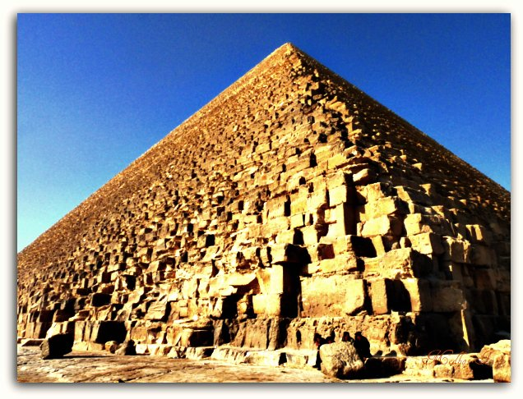
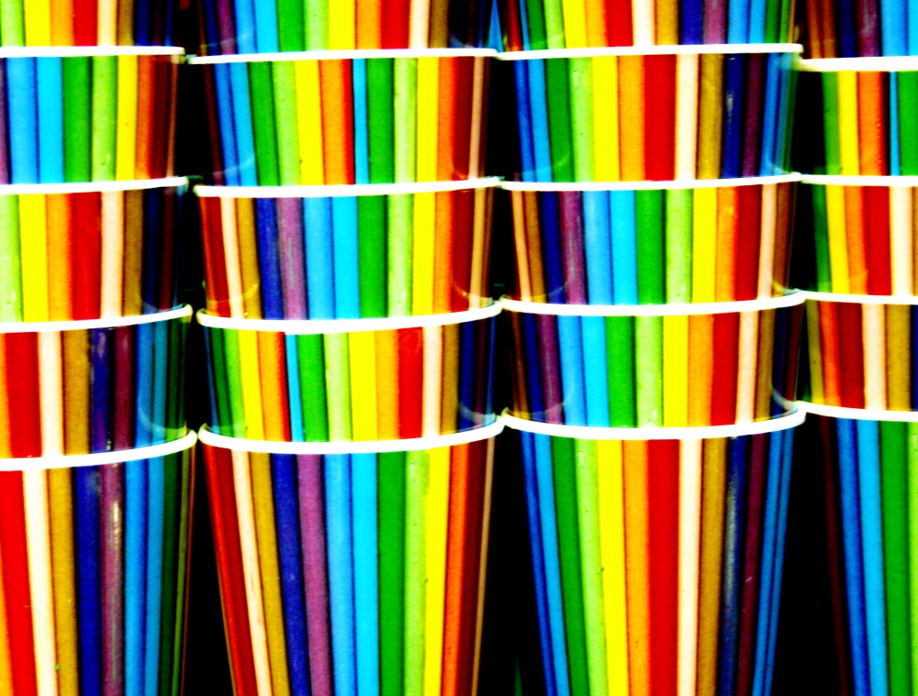
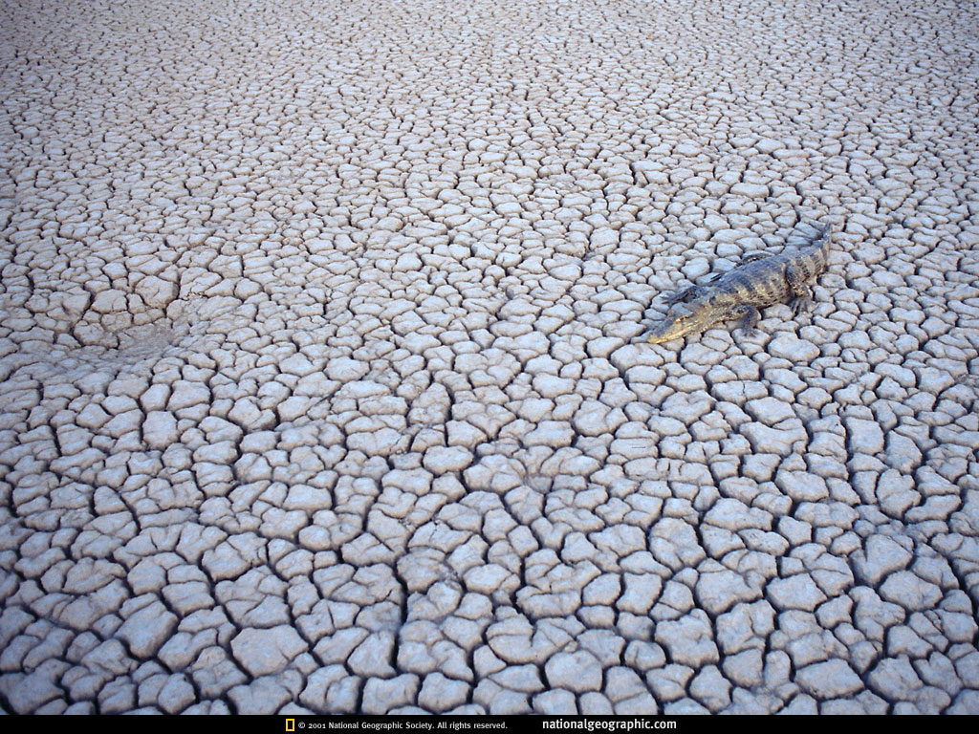
Feature Types
Shape!
Color!
Texture!
Notes:
Features can capture different aspects of a picture including things like shape, color or texture.

Slide 23
Color Features

Slide 24
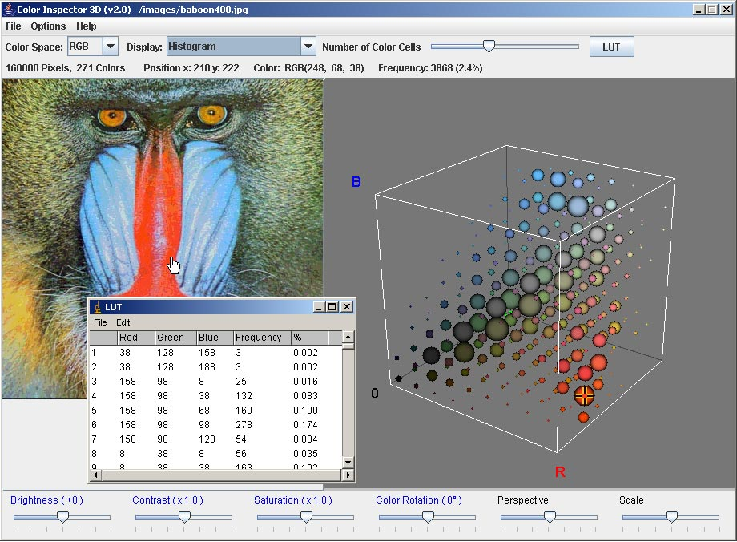
Color Histograms
Notes:
One common feature representation is color histograms. A color histogram is a 3d histogram representing what percentage of each color is present in an image. This can be computed in whatever color space you like – rgb, hsv, lab, etc.
How could you compute a color histogram?
Write pseudocode on board
Create 3d histogram of zeros (size numrbins x numgbins x numbbins)
for i=1:numrows
for j=1:numcols
calculate r bin for pixel I,j
calculate g bin for pixel I,j
calculate b bin for pixel I,j
increment corresponding r,g,b bin of your 3d histogram
end
End
Would this be a global or local representation as I’ve described it?

Slide 25
Uses of color in computer vision
Color histograms for indexing and retrieval
Swain and Ballard, Color Indexing, IJCV 1991.
source: Svetlana Lazebnik
Notes:
How would you use this for retrieval?
Calculate color hists of all database images. For a query calculate it’s color histogram and find the closest database histograms.

Slide 26
Uses of color in computer vision
Image segmentation
and retrieval
C. Carson, S. Belongie, H. Greenspan, and Ji. Malik, Blobworld: Image segmentation using Expectation-Maximization and its application to image querying, ICVIS 1999.
source: Svetlana Lazebnik
Notes:
Color has also been used for tasks like image segmentation. In this paper, the authors implement a color based segmentation method based on EM clustering. Then can retrieve images with similar color segments. E.g. retrieve images with segments that look like this one (query is top image, bottom shows retrieved results).

Slide 27
Uses of color in computer vision
Skin detection
M. Jones and J. Rehg, Statistical Color Models with Application to Skin Detection, IJCV 2002.
source: Svetlana Lazebnik
Notes:
Color has also been used successfully in other recognition tasks like skin detection. Though our skin colors look quite different, our skin hues tend to be similar. So you can train a model to recognize skin colored pixels and detect them in images.

Slide 28
Color features
Pros/Cons?
Notes:
Distinctive colors sometimes associated with particular objects – e.g. sky is blue, grass is green. But are they always?

Slide 29
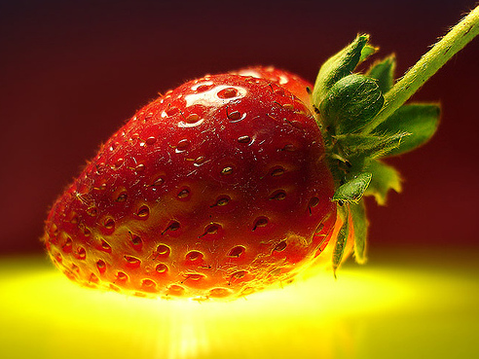
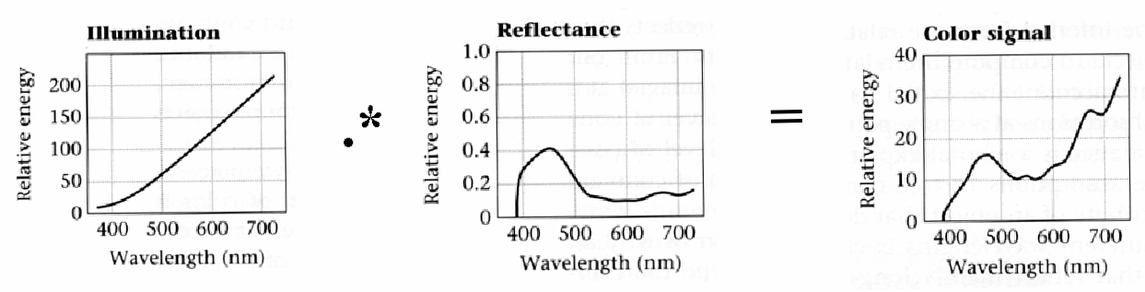
Interaction of light and surfaces
Reflected color is the result of interaction of light source spectrum with surface reflectance
source: Svetlana Lazebnik
Notes:
color of an object is not constant. The color of an object is an interaction between the color of the object (it’s surface reflectance) and the color of the illuminant.

Slide 30
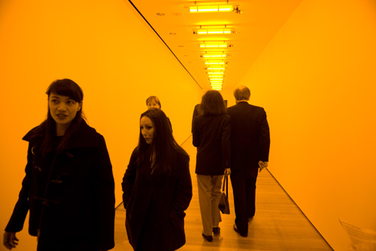
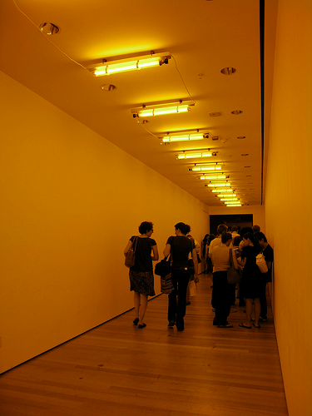
Interaction of light and surfaces
Olafur Eliasson, Room for one color, 1997
“In Olafur Eliasson’s Room for one color (1997) we actually only see one color. The room is illuminated by yellow monofrequency light. In contrast to ordinary white light containing the full colour spectrum, it consists of a single wavelength at the yellow end of the spectrum. The room appears colorless because the light reduces all the other colours to a scale comprised of yellow. On the other hand, everything stands out with crystal sharpness because there is far less information than usual for the eye to process. After a while, the eye compensates for this deficiency by generating an excess of the missing primaries of red and blue – which together yield violet. So when we move on into the adjacent space we begin by seeing everything as imbued with violet.”
source: Svetlana Lazebnik
Notes:
This property has led to some neat art work. For example this exhibit by olafur eliasson called room for one color.

Slide 31
Shape Features

Slide 32
Invariance
We might want our features to be robust to variations that can be present in images.
Slide source: Tom Duerig
Notes:
What kinds of variations can occur between pictures of a scene or object that you might want to be robust to?

Slide 33
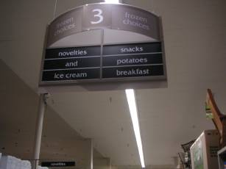
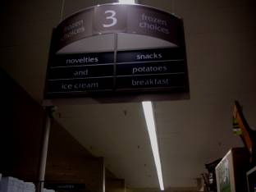
Types of invariance
Illumination
Slide source: Tom Duerig
Notes:
Brightness changes with illumination. If colored light then also color changes

Slide 34
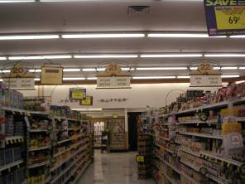
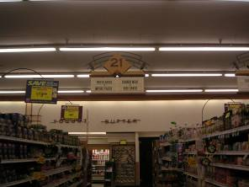
Types of invariance
Illumination
Scale
Slide source: Tom Duerig
Notes:
Need to recognize can of soup even if it appears as 10 pixels high in this image and 5 in this image.

Slide 35
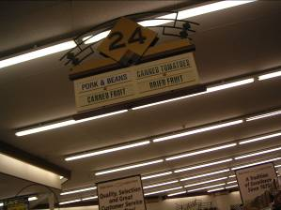
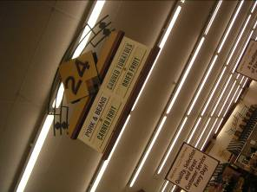
Types of invariance
Illumination
Scale
Rotation
Slide source: Tom Duerig

Slide 36
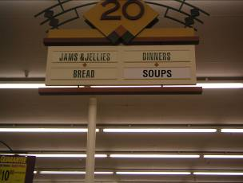
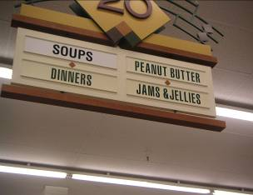
Types of invariance
Illumination
Scale
Rotation
Affine
Slide source: Tom Duerig
Notes:
Rotation, translation, scale, skew

Slide 37
Challenges: illumination
Illumination changes brightness of pixels. What remains unchanged?
image credit: J. Koenderink

Slide 38
Modeling images as functions
Notes:
Generally we can think of an image as a function

Slide 39
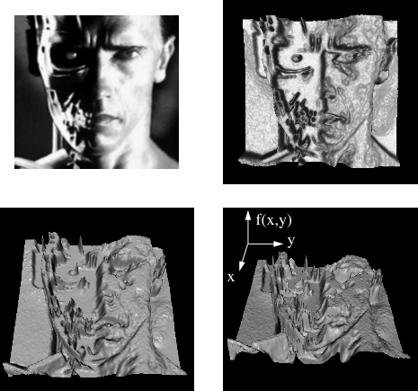
Images as functions
Intensity given position
Source: S. Seitz
Notes:
For example a function f(x,y) that is the intensity as a function of position. we can show this as height in a 3d image. So taller values are brighter values, and smaller values are dimmer values.
If you think about an image as a function, then you can apply other functions to your image.
Jumping ahead does anyone know what an edge would correspond to here? Changes in height.

Slide 40
Images as functions
We can think of an image as a function, f, from R² to R:
f(x, y) gives the intensity at position (x, y)
A color image is just three functions pasted together. We can write this as a “vector-valued” function:
Source: S. Seitz
Notes:
So here we are thinking about an image as a function where f(x,y) gives the intensity of the image at position (x,y)
A color image can then just be three functions r,g, and b at each location in the image. If you decide to use matlab for your project then this is how it will store your image – as a 2d or 3d matrix for grayscale and color images respectively.

Slide 41
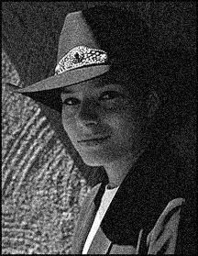
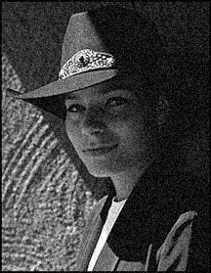

Motivation 1: Noise reduction
Given a camera and a still scene, how can you reduce noise?
Take lots of images and average them!
What’s the next best thing?
Source: S. Seitz
Notes:
So why do we want to think of an image as a function? Let’s look at the problem of noise reduction. Given a camera and a still scene a picture will contain some amount of noise depending on the sensor and the lighting conditions.
How could you reduce noise in an image – take lots of images and average them. But if we can only take one picture what could we do?

Slide 42
First attempt at a solution
Let’s replace each pixel with an average of all the values in its neighborhood
Source: S. Marschner
Notes:
Well we could replace each pixel with an average of it’s neighboring pixels. This might smooth out some of the noise.
We can do this with what’s called a convolution.

Slide 43
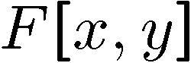
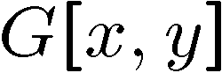
Moving Average In 2D
0 | 0 | 0 | 0 | 0 | 0 | 0 | 0 | 0 | 0
0 | 0 | 0 | 0 | 0 | 0 | 0 | 0 | 0 | 0
0 | 0 | 0 | 90 | 90 | 90 | 90 | 90 | 0 | 0
0 | 0 | 0 | 90 | 90 | 90 | 90 | 90 | 0 | 0
0 | 0 | 0 | 90 | 90 | 90 | 90 | 90 | 0 | 0
0 | 0 | 0 | 90 | 0 | 90 | 90 | 90 | 0 | 0
0 | 0 | 0 | 90 | 90 | 90 | 90 | 90 | 0 | 0
0 | 0 | 0 | 0 | 0 | 0 | 0 | 0 | 0 | 0
0 | 0 | 90 | 0 | 0 | 0 | 0 | 0 | 0 | 0
0 | 0 | 0 | 0 | 0 | 0 | 0 | 0 | 0 | 0
 | 0
0 | 0 | 0 | 0 | 0 | 0 | 0 | 0 | 0 | 0
0 | 0 | 0 | 0 | 0 | 0 | 0 | 0 | 0 | 0
0 | 0 | 0 | 90 | 90 | 90 | 90 | 90 | 0 | 0
0 | 0 | 0 | 90 | 90 | 90 | 90 | 90 | 0 | 0
0 | 0 | 0 | 90 | 90 | 90 | 90 | 90 | 0 | 0
0 | 0 | 0 | 90 | 0 | 90 | 90 | 90 | 0 | 0
0 | 0 | 0 | 90 | 90 | 90 | 90 | 90 | 0 | 0
0 | 0 | 0 | 0 | 0 | 0 | 0 | 0 | 0 | 0
0 | 0 | 90 | 0 | 0 | 0 | 0 | 0 | 0 | 0
0 | 0 | 0 | 0 | 0 | 0 | 0 | 0 | 0 | 0
Source: S. Seitz
Notes:
To replace each pixel by the average of itself and it’s 8 neighbors we can compute a moving average. Here we just walk through the image taking the average of each 3x3 block and writing it on the right.

Slide 44
Moving Average In 2D
0 | 0 | 0 | 0 | 0 | 0 | 0 | 0 | 0 | 0
0 | 0 | 0 | 0 | 0 | 0 | 0 | 0 | 0 | 0
0 | 0 | 0 | 90 | 90 | 90 | 90 | 90 | 0 | 0
0 | 0 | 0 | 90 | 90 | 90 | 90 | 90 | 0 | 0
0 | 0 | 0 | 90 | 90 | 90 | 90 | 90 | 0 | 0
0 | 0 | 0 | 90 | 0 | 90 | 90 | 90 | 0 | 0
0 | 0 | 0 | 90 | 90 | 90 | 90 | 90 | 0 | 0
0 | 0 | 0 | 0 | 0 | 0 | 0 | 0 | 0 | 0
0 | 0 | 90 | 0 | 0 | 0 | 0 | 0 | 0 | 0
0 | 0 | 0 | 0 | 0 | 0 | 0 | 0 | 0 | 0
 | 0 | 10
0 | 0 | 0 | 0 | 0 | 0 | 0 | 0 | 0 | 0
0 | 0 | 0 | 0 | 0 | 0 | 0 | 0 | 0 | 0
0 | 0 | 0 | 90 | 90 | 90 | 90 | 90 | 0 | 0
0 | 0 | 0 | 90 | 90 | 90 | 90 | 90 | 0 | 0
0 | 0 | 0 | 90 | 90 | 90 | 90 | 90 | 0 | 0
0 | 0 | 0 | 90 | 0 | 90 | 90 | 90 | 0 | 0
0 | 0 | 0 | 90 | 90 | 90 | 90 | 90 | 0 | 0
0 | 0 | 0 | 0 | 0 | 0 | 0 | 0 | 0 | 0
0 | 0 | 90 | 0 | 0 | 0 | 0 | 0 | 0 | 0
0 | 0 | 0 | 0 | 0 | 0 | 0 | 0 | 0 | 0
Source: S. Seitz
Notes:
Then we shift over and do the same thing.

Slide 45
Moving Average In 2D
0 | 0 | 0 | 0 | 0 | 0 | 0 | 0 | 0 | 0
0 | 0 | 0 | 0 | 0 | 0 | 0 | 0 | 0 | 0
0 | 0 | 0 | 90 | 90 | 90 | 90 | 90 | 0 | 0
0 | 0 | 0 | 90 | 90 | 90 | 90 | 90 | 0 | 0
0 | 0 | 0 | 90 | 90 | 90 | 90 | 90 | 0 | 0
0 | 0 | 0 | 90 | 0 | 90 | 90 | 90 | 0 | 0
0 | 0 | 0 | 90 | 90 | 90 | 90 | 90 | 0 | 0
0 | 0 | 0 | 0 | 0 | 0 | 0 | 0 | 0 | 0
0 | 0 | 90 | 0 | 0 | 0 | 0 | 0 | 0 | 0
0 | 0 | 0 | 0 | 0 | 0 | 0 | 0 | 0 | 0
 | 0 | 10 | 20
0 | 0 | 0 | 0 | 0 | 0 | 0 | 0 | 0 | 0
0 | 0 | 0 | 0 | 0 | 0 | 0 | 0 | 0 | 0
0 | 0 | 0 | 90 | 90 | 90 | 90 | 90 | 0 | 0
0 | 0 | 0 | 90 | 90 | 90 | 90 | 90 | 0 | 0
0 | 0 | 0 | 90 | 90 | 90 | 90 | 90 | 0 | 0
0 | 0 | 0 | 90 | 0 | 90 | 90 | 90 | 0 | 0
0 | 0 | 0 | 90 | 90 | 90 | 90 | 90 | 0 | 0
0 | 0 | 0 | 0 | 0 | 0 | 0 | 0 | 0 | 0
0 | 0 | 90 | 0 | 0 | 0 | 0 | 0 | 0 | 0
0 | 0 | 0 | 0 | 0 | 0 | 0 | 0 | 0 | 0
Source: S. Seitz
Notes:
And again.

Slide 46
Moving Average In 2D
0 | 0 | 0 | 0 | 0 | 0 | 0 | 0 | 0 | 0
0 | 0 | 0 | 0 | 0 | 0 | 0 | 0 | 0 | 0
0 | 0 | 0 | 90 | 90 | 90 | 90 | 90 | 0 | 0
0 | 0 | 0 | 90 | 90 | 90 | 90 | 90 | 0 | 0
0 | 0 | 0 | 90 | 90 | 90 | 90 | 90 | 0 | 0
0 | 0 | 0 | 90 | 0 | 90 | 90 | 90 | 0 | 0
0 | 0 | 0 | 90 | 90 | 90 | 90 | 90 | 0 | 0
0 | 0 | 0 | 0 | 0 | 0 | 0 | 0 | 0 | 0
0 | 0 | 90 | 0 | 0 | 0 | 0 | 0 | 0 | 0
0 | 0 | 0 | 0 | 0 | 0 | 0 | 0 | 0 | 0
 | 0 | 10 | 20 | 30
0 | 0 | 0 | 0 | 0 | 0 | 0 | 0 | 0 | 0
0 | 0 | 0 | 0 | 0 | 0 | 0 | 0 | 0 | 0
0 | 0 | 0 | 90 | 90 | 90 | 90 | 90 | 0 | 0
0 | 0 | 0 | 90 | 90 | 90 | 90 | 90 | 0 | 0
0 | 0 | 0 | 90 | 90 | 90 | 90 | 90 | 0 | 0
0 | 0 | 0 | 90 | 0 | 90 | 90 | 90 | 0 | 0
0 | 0 | 0 | 90 | 90 | 90 | 90 | 90 | 0 | 0
0 | 0 | 0 | 0 | 0 | 0 | 0 | 0 | 0 | 0
0 | 0 | 90 | 0 | 0 | 0 | 0 | 0 | 0 | 0
0 | 0 | 0 | 0 | 0 | 0 | 0 | 0 | 0 | 0
Source: S. Seitz
Notes:
And again.

Slide 47
Moving Average In 2D
0 | 0 | 0 | 0 | 0 | 0 | 0 | 0 | 0 | 0
0 | 0 | 0 | 0 | 0 | 0 | 0 | 0 | 0 | 0
0 | 0 | 0 | 90 | 90 | 90 | 90 | 90 | 0 | 0
0 | 0 | 0 | 90 | 90 | 90 | 90 | 90 | 0 | 0
0 | 0 | 0 | 90 | 90 | 90 | 90 | 90 | 0 | 0
0 | 0 | 0 | 90 | 0 | 90 | 90 | 90 | 0 | 0
0 | 0 | 0 | 90 | 90 | 90 | 90 | 90 | 0 | 0
0 | 0 | 0 | 0 | 0 | 0 | 0 | 0 | 0 | 0
0 | 0 | 90 | 0 | 0 | 0 | 0 | 0 | 0 | 0
0 | 0 | 0 | 0 | 0 | 0 | 0 | 0 | 0 | 0
 | 0 | 10 | 20 | 30 | 30
Source: S. Seitz
Notes:
And again.

Slide 48
Moving Average In 2D
0 | 0 | 0 | 0 | 0 | 0 | 0 | 0 | 0 | 0
0 | 0 | 0 | 0 | 0 | 0 | 0 | 0 | 0 | 0
0 | 0 | 0 | 90 | 90 | 90 | 90 | 90 | 0 | 0
0 | 0 | 0 | 90 | 90 | 90 | 90 | 90 | 0 | 0
0 | 0 | 0 | 90 | 90 | 90 | 90 | 90 | 0 | 0
0 | 0 | 0 | 90 | 0 | 90 | 90 | 90 | 0 | 0
0 | 0 | 0 | 90 | 90 | 90 | 90 | 90 | 0 | 0
0 | 0 | 0 | 0 | 0 | 0 | 0 | 0 | 0 | 0
0 | 0 | 90 | 0 | 0 | 0 | 0 | 0 | 0 | 0
0 | 0 | 0 | 0 | 0 | 0 | 0 | 0 | 0 | 0
 | 0 | 10 | 20 | 30 | 30 | 30 | 20 | 10
 | 0 | 20 | 40 | 60 | 60 | 60 | 40 | 20
 | 0 | 30 | 60 | 90 | 90 | 90 | 60 | 30
 | 0 | 30 | 50 | 80 | 80 | 90 | 60 | 30
 | 0 | 30 | 50 | 80 | 80 | 90 | 60 | 30
 | 0 | 20 | 30 | 50 | 50 | 60 | 40 | 20
 | 10 | 20 | 30 | 30 | 30 | 30 | 20 | 10
 | 10 | 10 | 10 | 0 | 0 | 0 | 0 | 0
Source: S. Seitz
Notes:
Till eventually this is what you get.
What has happened in this image on the right? It has smoothed out the noise of the 0 pixel in the midst of the 90s --- or smoothed out the noise in the image.

Slide 49
Generalization of moving average (Convolution)
Let’s replace each pixel with a weighted average of its neighborhood
The weights are called the filter kernel
What are the weights for a 3x3 moving average?
Source: D. Lowe
Notes:
Basically a convolution is doing this moving average but instead of weighting all neighbors equally as we just did we’re going to use a weighted average of the neighborhood aroudn a pixel.
These weights are called the filter kernel.
What would the weights for a 3x3 moving average look like (the one we just did)?

Slide 50
Generalization of moving average (Convolution)
Let’s replace each pixel with a weighted average of its neighborhood
The weights are called the filter kernel
What are the weights for a 3x3 moving average?
1/9
1/9
1/9
1/9
1/9
1/9
1/9
1/9
1/9
Source: D. Lowe
Notes:
What might be better than just taking the average? What kinds of weights might you want to use?

Slide 51
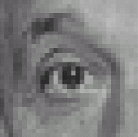
Practice with linear filters
0
0
0
?
0
1
0
0
0
0
Original
Source: D. Lowe
Notes:
What does this filter do?

Slide 52
Practice with linear filters
0
0
0
0
1
0
0
0
0
Original
Filtered
(no change)
Source: D. Lowe
Notes:
Nothing – each output pixel Is just 1times the center pixel plus zero times everyone else. So output same as input.

Slide 53
Practice with linear filters
0
0
0
?
0
0
1
0
0
0
Original
Source: D. Lowe
Notes:
What about this one?

Slide 54
Practice with linear filters
0
0
0
0
0
1
0
0
0
Original
Shifted left
By 1 pixel
Source: D. Lowe
Notes:
Right just shifts all pixels 1 to left.

Slide 55

Practice with linear filters
1
1
1
?
1
1
1
1
1
1
Original
Source: D. Lowe
Notes:
And this one?

Slide 56
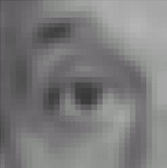
Practice with linear filters
1
1
1
1
1
1
1
1
1
Original
Blur (with a
box filter)
Source: D. Lowe
Notes:
Takes average of pixels neighborhood – this basically averages the pixel’s value with it’s neighbors values producing a blurred image.

Slide 57
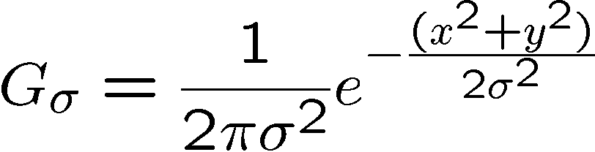
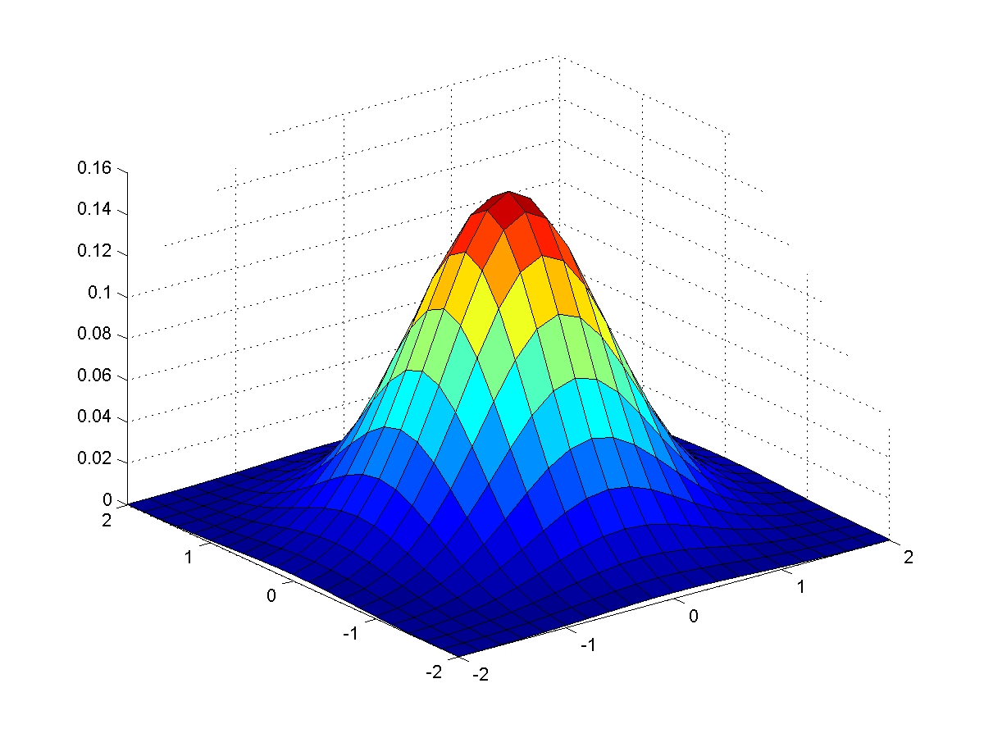
Gaussian Kernel
0.003 0.013 0.022 0.013 0.003
0.013 0.059 0.097 0.059 0.013
0.022 0.097 0.159 0.097 0.022
0.013 0.059 0.097 0.059 0.013
0.003 0.013 0.022 0.013 0.003
5 x 5, σ = 1
Constant factor at front makes volume sum to 1 (can be ignored, as we should re-normalize weights to sum to 1 in any case)
Source: C. Rasmussen
Notes:
But instead of just uniform weights we might care about nearby pixels more than pixels further away when smoothing a pixel. What’s commonly used to smooth images is a gaussian kernel.

Slide 58
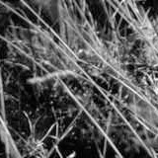
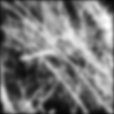
Example: Smoothing with a Gaussian
source: Svetlana Lazebnik

Slide 59
Edges
Notes:
Edges are something you’ll hear about a lot in cv. Because they give us a way to go from millions of pixels in an image down to a more sparse representation.

Slide 60
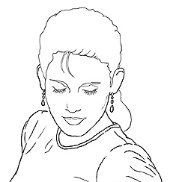
Edge detection
Goal: Identify sudden changes (discontinuities) in an image
Intuitively, most semantic and shape information from the image can be encoded in the edges
More compact than pixels
Ideal: artist’s line drawing (but artist is also using object-level knowledge)
Source: D. Lowe
Notes:
so what is an edge? An edge is a place where there are sudden changes in the image.
Ideally what we would get when running an edge detector would be an artists’s line drawing, but the artist is actually using object level knowledge to decide what lines to draw for an object and which are not needed.
A line drawing of a house or a person can look very convincing but there are no “lines” in the real world corresponding to the lines used in a drawing. What they really stand for is depth discontinuities, folds, occlusions etc.
we haven’t learned that this is what edges represent but we inherently know what they indicate – and there has been evidence that everyone from infants, to monkeys interpret line drawings as we do.
Edges encode most shape information. Edges are more robust to changes in illumination than pixels. Edges are more compact – millions of pixels only some are on edges.

Slide 61
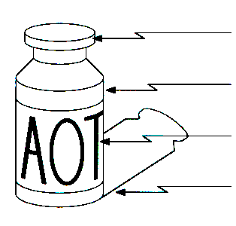
Origin of Edges
surface normal discontinuity
depth discontinuity
surface color discontinuity
illumination discontinuity
Edges are caused by a variety of factors
Source: Steve Seitz
Notes:
How do edges come about? They are really caused by a variety of factors.
Surface normal discontinuities – caused by an object bending away from the camera
depth discontinuity – the bottle is in front of the background.
Surface color discontinuity – where different colors on an object cause an edge
Illumination discontinuity – for example caused by edges between an object shadow and the background.

Slide 62

Characterizing edges
An edge is a place of rapid change in the image intensity function
intensity function (along horizontal scanline)
image
first derivative
edges correspond to extrema of derivative
source: Svetlana Lazebnik
Notes:
An edge is a place of rapid change in the intensity in an image.
If you look at the intensity as you scan across this red line it goes from bright to dark to bright again. If you look at the first derivative of the intensity function then you see these positive and negative spikes in the derivative. Edges correspond to extrema of the derivative.

Slide 63
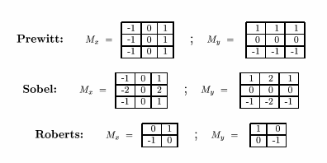
Edge filters
Approximations of derivative filters:
Convolve filter with image to get edge map
Source: K. Grauman
Notes:
So this leads us to how edges are found in an image. We use filters (similar to the gaussian filter we talked about earlier but here the filters are supposed to approximate a derivative). We can convolve these with an image to get an edge map.
Looking at the prewitt filter we will get a maximal response when the image is dark on one side and bright on the other.

Slide 64
Edge filters
Approximations of derivative filters:
Source: K. Grauman
Notes:
What kinds of edges would produce a large response by these filters?

Slide 65
Edge filters
Approximations of derivative filters:
Respond highly to vertical edges
Source: K. Grauman
Notes:
So

Slide 66
Edge filters
Approximations of derivative filters:
Source: K. Grauman
Notes:
What about these filters?

Slide 67
Edge filters
Approximations of derivative filters:
Respond highly to horizontal edges
Source: K. Grauman

Slide 68
Edges: example
source: Svetlana Lazebnik
Notes:
The bottom row shows the result of running two different kinds of filter on the original image.
What does the one on the left seem to be responding to? Vertical edges
Right? Horizontal edges.
Top right shows absolute value of combined vertical and horizontal edge response. Magnitude: Sqrt(dx^2+dy^2). Direction = arctan(dy/dx)

Slide 69
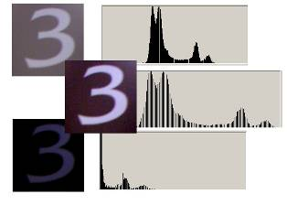

How to achieve illumination invariance
Use edges instead of raw values
Slide source: Tom Duerig
Notes:
Using edges makes a feature more or less invariant to changes in intensity.

Slide 70
Feature types!
The representation of these two umbrella’s should be similar….
Under a color based representation they look completely different!
Notes:
Then another choice you have to make is what kinds of image information you want to represent. For example, the representation we talked about for the balloon images is an example of a color based representation. That might work well for some tasks – but it wont’ work for others. For example what if we want to recognize umbrellas in images. Then under a color based representation they are going to look completely different!
Q: So what kind of feature that we touched on last class might be useful here?

Slide 71
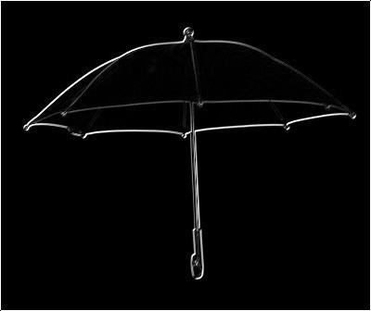
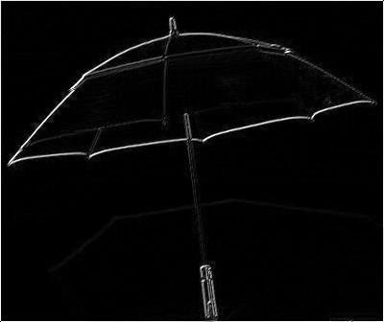
Edges
Red umbrella
Gray umbrella
Edges extracted using convolution with Prewitt filter
Notes:
Abs value of edge responses.

Slide 72
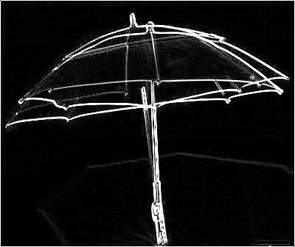
Edges
Edges overlayed from red and gray umbrellas.
Notes:
Looks pretty good, but still will never be an exact fit.

Slide 73
Local Features
Feature points (locations) + feature descriptors:
Where should we put the features?
How should we describe the features
Notes:
You have two choices to make when extracting local features. The first is where in the image should we features?
The first is where should we put the local features – which regions in the image should we describe. The second is how should we describe the local features – ie how do we go from pixel values to a vector of numbers representing that local region in the image.

Slide 74
Where should we put features?

Slide 75
Where to put features?
source: Svetlana Lazebnik
Notes:
Let’s look at one possible choice for where to put features.
Imagine you are going to use local features based on edges. Now where should we put a feature point? Where there is no edge? Somewhere along an edge? How about at a corner – intersection of two edges.

Slide 76

Distinctiveness in x,y
We should easily recognize the point by looking through a small window
Shifting a window in any direction should give a large change in intensity
“flat” region: no change in all directions
“edge”: no change along the edge direction
“corner”: significant change in all directions
Source: A. Efros
Notes:
image gradient has two or more dominant directions

Slide 77

Corner Detections
C.Harris and M.Stephens. "A Combined Corner and Edge Detector.“ Proceedings of the 4th Alvey Vision Conference: pages 147--151.
source: Svetlana Lazebnik

Slide 78
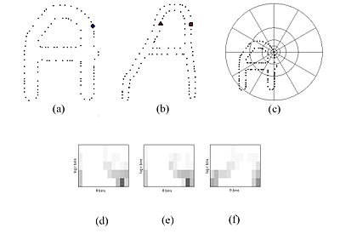
Toward denser sampling
Just sample points randomly on edges

Slide 79


Fully dense sampling
Or sample everywhere!
Notes:
Recent methods have seemed to move toward fully dense sampling – where we just compute a feature point every k pixels in the image
What have we lost here? Not invariant to scale changes! Maybe have to sample features at multiple scales.
Of course this is a lot of features! so then often later other things are done to make the representation smaller – like compute a bag of words histogram which we will talk about later, but often it seems to be better to sample densely for recognition problems.

Slide 80
How should we describe features?

Slide 81
SIFT
SIFT (Scale Invariant Feature Transform) - stable robust and distinctive local features
One of the most popular shape (edge) based features
Where to put them:
Originally sampled points distinctive in both position (x,y) and scale (SI – Scale Invariant)
Often now used with sampling on a dense grid

Slide 82
Feature descriptor
Notes:
Describes the orientation of edges around the feature point.
How do we calculate direction and magnitude of edges in an image? Let’s say we’ve calculated dx and dy (by convolution), then tan(theta) = dy/dx gives angle of edge and m = sqrt(dx^2+dy^2) gives magnitude of edge. We can bin the directions (theta) into a set of orientations, e.g. 8 different orientations, m gives magnitude of edge.

Slide 83
Feature descriptor
Based on 16*16 patches
4*4 subregions
8 orientation bins in each subregion
4*4*8=128 dimensions in total
Notes:
If used with DoG method then scale (size of image patch to be described) is selected, if dense then scale is user selected.

Slide 84
Rotation Invariance
Rotate all features to go the same way in a determined manner
A histogram is formed by quantizing the orientations into bins
Features are rotated according to peak of orientation histogram
Notes:
SIFT can also incorporate rotation invariance. Here we rotate all features to go the same way in a determined manner.
Assign an orientation to each keypoint, the keypoint descriptor can be represented relative to this orientation and therefore achieve invariance to image rotation

Slide 85

Eliminating rotation ambiguity
To assign a unique orientation:
Create histogram of local gradient directions in the patch
Assign canonical orientation at peak of smoothed histogram
0
2
π

Slide 86

Rotation Invariance
Slide source: Tom Duerig
Notes:
In the top image the peak of the orientation bin would be in the downwards direction while the bottom image would be in the rightward direction. We basically take the patch and rotate it to a canonical direction (ie rightward) before computing the feature descriptor. In this way you can encode rotation invariance.

Slide 87

SIFT output
Notes:
Here is an example sift output using keypoint detection. Arrow size and direction indicate the estimated scale and orientation. But as I mentioned earlier a lot of recent methods have moved toward simply sample sift points densely with fixed scale and orientation

Slide 88
Other shape features
Notes:
There are a number of other kinds of shape/edge based features that you might see in papers we read.

Slide 89
Shape Context
"Matching with Shape Contexts”: Belongie, Malik 2000
(a) and (b) are the sampled edge points of the two shapes. (c) is the diagram of the log-polar bins used to compute the shape context. (d) is the shape context for the circle, (e) is that for the diamond, and (f) is that for the triangle. As can be seen, since (d) and (e) are the shape contexts for two closely related points, they are quite similar, while the shape context in (f) is very different.
Notes:
For example some features like shape context have explored different ways of collecting information about edges around a point. Here you simply compute a histogram of where other edge points occur relative to your feature point. In particular a log polar binning strategy is used so that bins nearby the feature point are smaller than bins further away. The figures below show the actual shape context histograms for these 3 points. You can see that the two left plots (corresponding to similar locations on two “A” images) look more similar than the third plot.

Slide 90

Geometric Blur
“Geometric Blur for Template Matching” A. Berg & Malik, 2001
Notes:
A similar idea is the geometric blur feature. Here spatially varying blur is applied around a feature point so that edges further from the point are blurred more and then subsampled to form the descriptor.
Q: What do you think motivates using this kind of spatially varying blur?

Slide 91

Geometric Blur
“Geometric Blur for Template Matching” A. Berg & Malik, 2001
Notes:
In fact what this feature does it it computes several channels (edge energy in different orientations), applies the spatially varying blur for each channel separately and then subsamples points for the final descriptor.

Slide 92



Histograms of Oriented Gradients
Navneet Dalal and Bill Triggs, 2005
HOG feature map
Similar to SIFT
Computed on dense grid of uniformly spaced cells
Good exploration of parameter space (gradient scale, orientation binning, spatial binning, contrast normalization)
Commonly used for pedestrian detection and general object detection
Root filter
Part filters
Deformation weights
Notes:
I should mention that most recent methods have moved toward dense sampling of features, ie features sampled every k pixels in an image (e.g. k=4) even for SIFT features

Slide 93
Texture Features

Slide 94






Texture Features
Texture is characterized by the repetition of basic elements or textons
Generally, it is the identity of the textons, not their spatial arrangement, that matters
Julesz, 1981; Cula & Dana, 2001; Leung & Malik 2001; Mori, Belongie & Malik, 2001; Schmid 2001; Varma & Zisserman, 2002, 2003; Lazebnik, Schmid & Ponce, 2003

Slide 95




Texture Histograms
histogram
Universal texton dictionary
Julesz, 1981; Cula & Dana, 2001; Leung & Malik 2001; Mori, Belongie & Malik, 2001; Schmid 2001; Varma & Zisserman, 2002, 2003; Lazebnik, Schmid & Ponce, 2003
Can be computed locally or globally
Notes:
How could we compute these? Convolve the image with a bunch of filters and measure the total response to each filter type. Then if you wanted to retrieve images that looked like this one (ie polka dotted) you could compare their texture histograms using ssd and find those with small distances. (rule of thumb - generally you get highest response for a filter kernal when the image looks like that filter kernel)

Slide 96
What can we do with features?

Slide 97


Finding correspondences
?
source: Svetlana Lazebnik

Slide 98
Finding correspondences
?
( )
?
( )
=
feature descriptor
feature descriptor
Need to compare feature descriptors of local patches surrounding interest points
source: Svetlana Lazebnik

Slide 99
Comparing Feature descriptors
How to compare two such vectors?
Sum of squared differences (SSD)
Not invariant to intensity change
Normalized correlation
Invariant to intensity change
source: Svetlana Lazebnik
Notes:
Norm corr – dot product of the two vectors divided by their lengths (normalized)

Slide 100
Example: object recognition
The SIFT features of training images are extracted and stored
For a query image
Extract SIFT feature
Find nearest neighbor match
Given 3 keypoint matches, perform geometric verification

Slide 103
Useful Code
VLFEAT (http://www.vlfeat.org/index.html)
open source library implementing various feature descriptors, clustering, matching algorithms

Slide 104
Text Features

Slide 105
Features == Words! (or n-grams, ie strings on n words)

Slide 106
Representation questions
Model whole document or subparts of documents - global vs local
Words vs strings - do you want to allow for strings not in the dictionary/lexicon common in folksonomies
Noise words – some words may not be related to content (e.g. stop words: a, and, the)
Orderless (bag of words) vs representations that care about order/syntax etc.

Slide 107

Document Vectors
Notes:
In order to talk about nearest neighbor classifiers we will first have to come up with a representation for documents. If you think about a document you can see it as just a collection of words.

Slide 108

Document Vectors
Represent document as a “bag of words”
Notes:
So we can very simply represent documents as a bag of words. Basically you are going to take all of the words from a document and throw them into a bag and shake them around. This kind of representation has no idea about the order of words or that this word comes at the beginning of the document or anything about the structure of the documents. You just know what words are contained in the document and perhaps something about the frequency of each word..

Slide 109
Example
Doc1 = “the quick brown fox jumped”
Doc2 = “brown quick jumped fox the”
Notes:
Here are two example documents. Doc1 says …, doc2 says…

Slide 110
Example
Doc1 = “the quick brown fox jumped”
Doc2 = “brown quick jumped fox the”
Would a bag of words model represent these two documents differently?
Notes:
From what I just told you about bag of words representations, do you think that a model like this would represent these two documents differently? Right bag of words representations for these would be the same, each word is treated independently from every other word.

Slide 111
Document Vectors
Documents are represented as “bags of words”
Represented as vectors when used computationally
Each vector holds a place for every term in the collection
Therefore, most vectors are sparse
Slide from Mitch Marcus
Notes:
We can think of this bag of words as a vector, where each index in the vector corresponds to a term in the collection. Why would most vectors be sparse? Because each document will only contain a small subset of all the possible words in the english language.

Slide 112
Document Vectors
Documents are represented as “bags of words”
Represented as vectors when used computationally
Each vector holds a place for every term in the collection
Therefore, most vectors are sparse
Lexicon – the vocabulary set that you consider to be valid words in your documents.
Usually stemmed (e.g. running->run)
Slide from Mitch Marcus
Notes:
A lexicon is the vocabulary set that you consider to be valid words in documents. You can play some tricks by stemming for example turning the word running into run so that these map to the same word in your lexicon. That way if you see a document containing the word running you know it is similar to a document containing the word run.

Slide 113
Document Vectors: One location for each word.
A
B
C
D
E
F
G
H
I
nova galaxy heat h’wood film role diet fur
10 5 3
5 10
10 8 7
9 10 5
10 10
9 10
5 7 9
6 10 2 8
7 5 1 3
“Nova” occurs 10 times in text A
“Galaxy” occurs 5 times in text A
“Heat” occurs 3 times in text A
(Blank means 0 occurrences.)
Slide from Mitch Marcus
Notes:
So here is the document vector for document A, the lexicon is shown along the top row. what does this tell us?

Slide 114
Document Vectors: One location for each word.
A
B
C
D
E
F
G
H
I
nova galaxy heat h’wood film role diet fur
10 5 3
5 10
10 8 7
9 10 5
10 10
9 10
5 7 9
6 10 2 8
7 5 1 3
“Nova” occurs 10 times in text A
“Galaxy” occurs 5 times in text A
“Heat” occurs 3 times in text A
(Blank means 0 occurrences.)
Slide from Mitch Marcus
Notes:
So here is the document vector for document A.

Slide 115
Document Vectors
Document ids
A
B
C
D
E
F
G
H
I
nova galaxy heat h’wood film role diet fur
10 5 3
5 10
10 8 7
9 10 5
10 10
9 10
5 7 9
6 10 2 8
7 5 1 3
Slide from Mitch Marcus

Slide 116
Vector Space Model
Documents are represented as vectors in term space
Terms are usually stems
Documents represented by vectors of terms
Slide from Mitch Marcus

Slide 117
Vector Space Model
Documents are represented as vectors in term space
Terms are usually stems
Documents represented by vectors of terms
A vector distance measure between documents is used to measure document similarity
Slide from Mitch Marcus

Slide 118
Document Vectors
Document ids
A
B
C
D
E
F
G
H
I
nova galaxy heat h’wood film role diet fur
10 5 3
5 10
10 8 7
9 10 5
10 10
9 10
5 7 9
6 10 2 8
7 5 1 3
Slide from Mitch Marcus

Slide 119
Similarity between documents
A = [10 5 3 0 0 0 0 0];
G = [5 0 7 0 0 9 0 0];
E = [0 0 0 0 0 10 10 0];

Slide 120
Similarity between documents
A = [10 5 3 0 0 0 0 0];
G = [ 5 0 7 0 0 9 0 0];
E = [ 0 0 0 0 0 10 10 0];
Treat the vectors as binary = number of words in common.
Sb(A,G) = ?
Sb(A,E) = ?
Sb(G,E) = ?
Which pair of documents are the most similar?

Slide 121
Similarity between documents
A = [10 5 3 0 0 0 0 0];
G = [5 0 7 0 0 9 0 0];
E = [0 0 0 0 0 10 10 0];
Sum of Squared Distances (SSD) =
SSD(A,G) = ?
SSD(A,E) = ?
SSD(G,E) = ?

Slide 122

Similarity between documents
A = [10 5 3 0 0 0 0 0];
G = [5 0 7 0 0 9 0 0];
E = [0 0 0 0 0 10 10 0];
Angle between vectors: Cos(θ) =
Dot Product:
Length (Euclidean norm):

Slide 123
Some words give more information than others
Does the fact that two documents both contain the word “the” tell us anything? How about “and”? Stop words (noise words): Words that are probably not useful for processing. Filtered out before natural language is applied.
Other words can be more or less informative.
No definitive list but might include things like:
http://www.dcs.gla.ac.uk/idom/ir_resources/linguistic_utils/stop_words
Notes:
As we said words in our lexicon can be more or less informative.

Slide 124
Vector Space Model
Documents are represented as vectors in term space
Terms are usually stems
Documents represented by vectors of terms
A vector distance measure between documents is used to measure document similarity
Terms in a vector can be “weighted” in many ways
Slide from Mitch Marcus

Slide 125
Assigning Weights to Terms
Binary Weights
Raw term frequency
tf x idf
Want to weight terms highly if they are
frequent in relevant documents … BUT
infrequent in the collection as a whole
Slide from Mitch Marcus
Notes:
There are different ways to assign weights to terms. We’ve seen two ways already.
We might use binary weights – whether or not the word occurs without taking into account frequency of appearance.
We might use weights based on term frequency – how often a word occurs. So words that occur more often get higher weight when calculating similarity.
One last common way of assigning weights is called tf x idf – here we say that we want to weight terms highly if they are frequent in the relevant documents, but infrequent in the collection as a whole. Why might this be good? Because if a term is frequent in relevant document, but infrequent in general then it is a good indicator that when you see it you are seeing a relevant document. For example say your goal is to find documents about “horses”, now a term like “rider” might be quite frequent in documents about horses, but very infrequent in general documents. So if you see the word “rider” in a document it’s likely to be about “horses”.

Slide 126
TF x IDF Weights
tf x idf measure:
Term Frequency (tf) – how often a term appears in a document
Inverse Document Frequency (idf) -- a way to deal with terms that are frequent across many documents
Goal: Assign a tf * idf weight to each term in each document
Slide from Mitch Marcus

Slide 127
TF x IDF Calculation
Slide from Mitch Marcus

Slide 128
TF x IDF Calculation
Slide from Mitch Marcus
Notes:
Want the term to be frequent in the document

Slide 129
TF x IDF Calculation
Slide from Mitch Marcus
Notes:
but infrequent in the whole collection. A word like that will be weighted higher.
Than a term that is frequent in the document, but also frequent in the whole collection – why? Because that means that seeing that term doesn’t provide much information about which document you are seeing. For example you expect the word “the” to be frequent in your document, but also frequent in the whole collection of documents. Therefore the word “the” isn’t very information and should get lower weight.

Slide 130
Inverse Document Frequency
IDF provides high values for rare words and low values for common words
For a collection
of 10000 documents
Slide from Mitch Marcus

Slide 131
TF x IDF Normalization
Normalize the term weights (so longer documents are not unfairly given more weight)
The longer the document, the more likely it is for a given term to appear in it, and the more often a given term is likely to appear in it. So, we want to reduce the importance attached to a term appearing in a document based on the length of the document.
Slide from Mitch Marcus

Slide 132
Pair-wise Document Similarity
Documents now represented as vectors of TFxIDF weights
A
B
C
D
Similarity can be computed as usual on these new weight vectors (e.g. cos(θ) here)
nova galaxy heat h’wood film role diet fur
1 3 1
5 2
2 1 5
4 1
Slide from Mitch Marcus

Slide 133
Pair-wise Document Similarity
Documents now represented as vectors of TFxIDF weights
Similarity can be computed as usual on these new weight vectors (e.g. cos(θ) here)
Slide from Mitch Marcus

Slide 134
Issues
Problems that arise using the vector space model:
synonymy: many ways to refer to the same object, e.g. car and automobile
polysemy: most words have more than one distinct meaning, e.g. bank, python, chip
Can we infer relationships between words for better document similarity?
Slide from Melanie Martin

Slide 135
The Problem
Example: Vector Space Model
(from Lillian Lee)
auto
engine
bonnet
tyres
lorry
boot
car
emissions
hood
make
model
trunk
make
hidden
Markov
model
emissions
normalize
Synonymy
Will have small cosine
but are related
Polysemy
Will have large cosine
but not truly related
Slide from Melanie Martin

Slide 136
LSA
Latent Semantic Indexing/Analysis was proposed to address these two problems with the vector space model
Idea (Deerwester et al):
“We would like a representation in which a set of terms, which by itself is incomplete and unreliable evidence of the relevance of a given document, is replaced by some other set of entities which are more reliable indicants. We take advantage of the implicit higher-order (or latent) structure in the association of terms and documents to reveal such relationships.”
Slide from Melanie Martin

Slide 137
LSA
Implementation: four basic steps
Construct term by document matrix
Convert matrix entries to weights
Rank-reduced Singular Value Decomposition (SVD) performed on matrix
all but the k highest singular values are set to 0
produces k-dimensional approximation of the original matrix (in least-squares sense)
this is the “semantic space”
Compute similarities between entities in semantic space (usually with cosine)
Slide from Melanie Martin

Slide 138
LSA
SVD
unique mathematical decomposition of a matrix into the product of three matrices:
two with orthonormal columns
one with singular values on the diagonal
similarity measure based on co-occurrence
finds optimal projection into low-dimensional space
Slide from Melanie Martin
Notes:
the singular value decomposition (SVD) is a factorization of a matrix into 3 matrices.

Slide 139

Singular Value Decomposition
v₁^{T} v₂^{T} ….. v_{N}^{T}
u₁
u₂
:
:
u_{M}
0
W
U
S
V^{T}
Slide from Dharmendra P. Kanejiya
Notes:
The diagonal entries Σ_{i,i} of Σ are known as the singular values of M. The m columns of U and the n columns of V are called the left-singular vectors and right-singular vectors of M, respectively.
The singular value decomposition and the eigendecomposition are closely related. Namely:
The left-singular vectors of M are eigenvectors of MM*.
The right-singular vectors of M are eigenvectors of M*M.
The non-zero-singular values of M (found on the diagonal entries of Σ) are the square roots of the non-zero eigenvalues of both M*M and MM*.

Slide 140
New Documents
Projecting a new document in LS space
Calculate the frequency count [d_{i}] of words in the document.
d = U S v^{T}
⇒ U^{T}d = Sv^{T}
Slide from Dharmendra P. Kanejiya

Slide 141
Semantic Similarity Measure
To find similarity between two documents, project them in LS space
Then calculate the cosine measure between their projection
With this measure, various problems can be addressed e.g., natural language understanding, cognitive modeling etc
Slide from Dharmendra P. Kanejiya

Slide 142

Other measures of word relatedness
WordNet Distance – measure the length of the shortest path between words in WordNet
Normalized Google Distance
where M is the total number of web pages searched by Google; f(x) and f(y) are the number of hits for search terms x and y, respectively; and f(x, y) is the number of web pages on which both x and y occur.

Slide 143
Bag of words for Images

Slide 144



Bag-of-features models
Bag of ‘features’
Object
source: Svetlana Lazebnik
Notes:
Today we’re talking about bag of features models. Here you model objects as a bag of features.

Slide 145


Bag of features: outline
Extract features
source: Svetlana Lazebnik
Notes:
Bag of features models often follow a similar pipeline.
First you might extract some features from our images.

Slide 146
Bag of features: outline
Extract features
Learn “visual vocabulary”
source: Svetlana Lazebnik
Notes:
Then since with images we don’t have these nice distinct units called words, so we need to learn an equivalent visual vocabulary consisting of the pieces that make up images.

Slide 147
Bag of features: outline
Extract features
Learn “visual vocabulary”
Represent images by frequencies of “visual words”
source: Svetlana Lazebnik
Notes:
Once you have a visual vocabulary you can then represent images the same way you would represent documents, as the frequencies of each of the visual words in your vocabulary.

Slide 148
2. Learning the visual vocabulary
…
Clustering
Slide credit: Josef Sivic
Notes:
One way that’s often used to learn a visual vocabulary is to take all of your visual features and cluster them into groups.
For example you extract a bunch of features from lots of images (often sift features are used) then you run a clustering algorithm like k-means to group the features into clusters.

Slide 149
2. Learning the visual vocabulary
Visual vocabulary
…
Clustering
Slide credit: Josef Sivic
Notes:
Your visual words are then one representative from each cluster – the cluster centers

Slide 150
K-means clustering (reminder)
Want to minimize sum of squared Euclidean distances between points x_{i} and their nearest cluster centers m_{k}
Algorithm:
Randomly initialize K cluster centers
Iterate until convergence:
Assign each data point to the nearest center
Recompute each cluster center as the mean of all points assigned to it
source: Svetlana Lazebnik
Notes:
Reminder of kmeans. Cluster centers or the patch nearest to the cluster center are your “visual vocabulary”

Slide 151

Example visual vocabulary
Fei-Fei et al. 2005
Notes:
Here is a visual vocabulary learned from small image patches. What’s an image patch – vector of numbers. So kmeans clusters those vectors. Mean – just a new vector of numbers which you can view as a patch.

Slide 152

Image Representation
For a query image
Extract features
Associate each feature with the nearest cluster center (visual word)
Accumulate visual word frequencies over the image
Visual vocabulary
x
x
x
x
x
x
x
x
x
x
Notes:
So your visual vocabulary are the cluster centers – your visual words. For a query image you extract it’s features, associate each feature with the nearest cluster center and then accumulate visual word frequencies over the image.

Slide 153
3. Image representation
frequency
…..
codewords
source: Svetlana Lazebnik
Notes:
So you can represent an image as a histogram of the visual words it contains. Usually this histogram is normalized so that it sums to 1. Q: why?
There are some recent modifications to this very common algorithm. For example you might encode each feature as the nearest k visual words. Q: What advantages might that have? encoding by the nearest codeword could have problems (say you are actually close to 2 codewords) then this hard assignment can be problematic. Something that looks at the nearest k could be better – an example of this is the LLC algo. Locally linear coding (tom huang) which performs a K-nearest neighbor search and then solves a small constrainted least square fitting problem to compute a sparse coding for each feature.

Slide 154
4. Image classification
CAR
frequency
…..
codewords
Given the bag-of-features representations of images from different classes, how do we learn a model for distinguishing them?
source: Svetlana Lazebnik
Notes:
Then the question is how do you go from a bag of words representation like this to predicting the correct category for an image?

Slide 155







Image Categorization
What is this?
helicopter
Choose from many categories
Notes:
This is the image categorization problem. So given an image of an object, our goal is to predict the right class from a large number of categories. Here we want to predict helicopter. Notice our goal is image categorization – so we don’t need to predict where the helicopter is, just that there is a helicopter in the image.
Q: why might this be an easier problem than localization? Because just choosing from k categories (where k is say 100). Localization – say predicting a bounding box around the object – is choosing from many more possibilities (millions of possible bounding boxes for each image). Also in image categorization we can take advantage of the fact that objects are often correlated with their backgrounds, e.g. dolphins are in the water. So both the object and it’s background can help us determine what object is present.

Slide 156
Image Categorization
SVM/NB
Csurka et al (Caltech 4/7)
Nearest Neighbor
Berg et al (Caltech 101)
Kernel + SVM
Grauman et al (Caltech 101)
Multiple Kernel Learning + SVMs
Varma et al (Caltech 101)
…
What is this?
Choose from many categories
Notes:
There has been a lot of work on this problem many focused on training classifiers to recognize the image category. We will discuss the first paper a little bit today, but the others are quite related – many using SVMs of different forms for image classification.

Slide 157

Incorporating spatial info
Represent images as a spatially related features
Notes:
We might also represent images using a bag of words model. Here we would need some notion of words for the visual domain.
Often what people do is vector quantize features (like SIFT) using k-means or some other clustering algorithm.
Then the cluster centers become our visual vocabulary and images are represented as a histogram over visual words. So, in a query image for each feature you would find the closest cluster center and then increment that bin of the image histogram to come up with a vector representation for the image.

Slide 158
Slide credit: Svetlana Lazebnik
Notes:
Based on idea from grauman & darrell – where feature space is partitioned into increasingly coarser grids.
Here we partition the image into increasingly fine sub-regions and compute histograms of local features inside each sub-region. Lowest level of pyramid corresponds to bag of words representation while higher levels correspond to matching at a smaller spatial scale.
Why is this good? Simple, computationally efficient extension of bag of features representations.

Slide 159
Slide credit: Svetlana Lazebnik
Notes:
Two points are said to match if they fall into the same cell of the grid. So matches at lowest level can happen anywhere in the image, matches at next level have to be in same quadrant and so on.
Similarity at higher levels of pyramid means that the images are closer than similarity at lower levels. Therefore we weight accordingly. Intuitively – penalize matches found in larger cells because they involve increasingly dissimilar features (features less close spatially in the image).
Similarity is measured as histogram intersection function (just take min over each bin and sum).

Slide 160

Distinctiveness in x,y
Key property: in the region around a corner, image gradient has two or more dominant directions
C.Harris and M.Stephens. "A Combined Corner and Edge Detector.“ Proceedings of the 4th Alvey Vision Conference: pages 147--151.
source: Svetlana Lazebnik

Slide 161

Distinctiveness in x,y and scale
Find points that are distinctive in both x,y and scale
Provides some invariance to scale changes
Notes:
Why might you want to be distinctive in scale?

Slide 162

DoG
Gaussian blurred images
Notes:
To do this we blur the image with gaussians of different standard deviations – this gives original image down to very blurred image

Slide 163
DoG
Gaussian blurred images
DoG images
Notes:
Then you can compute bandpass images by subtracting one blurred version of an original image from another, less blurred version of the original. So you can separate the image into it’s frequency components from very high frequency (small spatial scale) to very low frequency (low spatial scale)

Slide 164
Maxima and minima in a
3*3*3 neighborhood
Notes:
Now we can find points that are distinctive both in x,y and scale by looking for maxima and minima in this dog space.

Slide 165
Distinctiveness in x,y and scale
Notes:
This gives us a selected scale for each feature point (visualized by the length of the arrow on the right). So if we have two versions of the same image, the scale selected in the left image will be larger than the one selected in the right image (ideally by the same ratio as the ratio of image sizes). Of course in practice this isn’t always perfect when images aren’t exactly repeated examples.

Slide 166
Reducing dimensionality
Feature descriptors are still large (e.g. 128 dimensions).
If you have many descriptors to compare in a single image comparing to many images is costly
What can you do to speed things up?
Reduce dimensionality of descriptors (e.g. PCA)
Make look-up fast

Slide 167

Principal Components Analysis (PCA)
A sample of n observations in space
Goal: to account for the variation in a sample
in as few variables as possible for dimension reduction
Notes:
In pca we want to reduce the dimensionality of the data and account for the variation in as few variables as possible.

Slide 168

Principal Components Analysis (PCA)
1st PC (z1) is the direction along which data varies the most
2nd PC (z2) is the next direction along which data varies the most, perpendicular to the 1st PC
…
Truncate components to some small number for dimensionality reduction. Each data point then becomes a point in this new coordinate space.
Notes:
The first pc corresponds to the direction along which the data varies the most
2nd pc corresponds to next direction along which data varies the most that is also perpendicular to the 1st pc… etc - computed by taking the eigen-decomposition of X’X (X is data matrix with zero empirical mean) (1st pc is the eigenvector with the largest eigenvalue, 2nd …).
The PC’s form a coordinate space for the data points. To reduce the dimensionality to a dimension d we just throw out all components after d. Each data point is then a point in this new lower dimensional coordinate space.
We’ll probably talk about this more later when we talk about the eigenfaces approach to face recognition.

